Slide 1
Hermes Microvision, Inc. Presents
ADC (Automatic Defect Classfication)

Slide 2
Summary for current status and objective

Slide 3
ADC – Current status
Problem statement:
Most apps used image pattern (Training sampling) for classification only. But it is hard to apply on In-lined ADC for production wafer. Most case, it is just useful on single result.
System supplied 102 features. However, very few users used them for classification. Based on discussion with some users, here are the comments for why they didn’t use it.
Too many features and most of them are listed with no. only. No idea what are those features for.
Accuracy is a big problem. For some cases, user tried to use features to do the binning for the results inspected from first wafer. However, it is not applicable for other production wafers.

Slide 4
ADC – Current status (Cont.)
Objective
Figure out why user is hard to use current ADC features:
Definition is not clear for features?
Accuracy is not good for some features?
Interface is too complicated?
Training is not enough?
Find a way to create in-lined ADC:
Currently, some users are using MDC (Manual Defect Classification) only since the binners user defined are not workable online for production wafers.
Needs to define a good way for how to create an Inline-Auto-Defect-Classification.
Easy and time saving for creation.
Applicable on production wafers.

Slide 5
ADC – Features vs. Imaging pattern
Common used features and current status feedback from users
Signal: -- Accurate and useful
Grey level, Threshold, Strength
Sizing: Not accurate and useless
Length, Height, Area
Location: -- Accurate and workable.
ALB and Pattern grouping
Others: -- Needs to define case by case. For example:
Misalignment, Wrong reference, Bridge ….
Image pattern: Common used. It is good for single result. But not useful on production
Classfier1, Classfier2, Classfier3, Classfier4
Features
Imaging

Slide 6
ADC – Plan
Feature identification
Identify each feature:
Definition
Accuracy
Applicability
Binner recommendation
Obviously, just using image pattern (Classifier) is not easy to get a stable In-lined ADC binners.
Needs to find out a best way to combine the features and image patterns together to get most stable and time saving binners (Please see next two pages for example).

Slide 7
ADC – How to create an Inline ADC
Nuisance
Classifiers 2 with all features applied
DOI1
DOI2
Raw data
DOI3
DOI4
DOI5
DOI6
Current binner -- Most users just used image pattern (Like classifiers 2) to do the binning. Here is the impact by using this way.
Time consuming – Needs to train a lot image as sampling.
Accuracy is bad – More DOI types, less accuracy.
Not applicable online – Just workable on single result.

Slide 8
ADC – How to create an Inline ADC
Nuisance
False or Nuisance
Classfier2
DOI1
DOI2
Feature 3
Classfier2
DOI3
Raw data
Feature 1
Feature 2
DOI4
Classfier2
Feature 4
DOI5
Classfier2
DOI6
Recommended binner -- Benefit as below
Time saving – Easy to find the cut line for each feature and only need to train few sampling on the end of the binner.
Accuracy is good – Feature is not easy to be impacted btw the variation of wafer to wafer or run to run.
Applicable online – Since the accuracy is good, it is much stable to use it for production
Nuisance

Slide 9
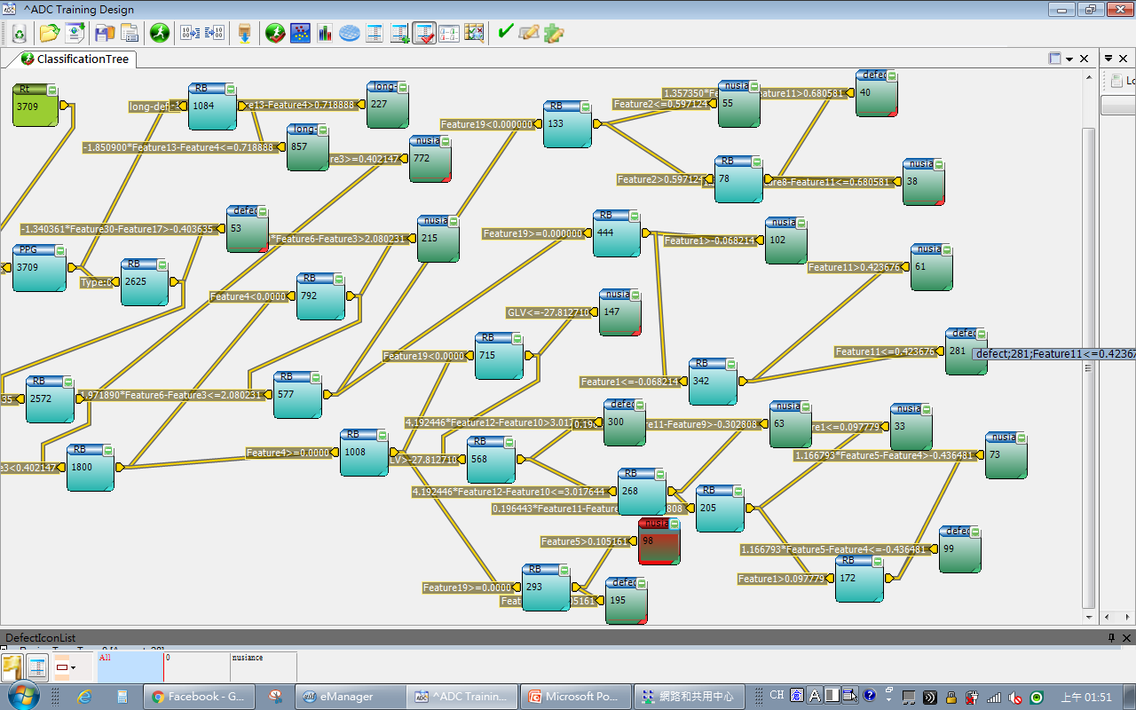
ADC – It’s good?
Nuisance

Slide 10
Request from apps

Slide 11
ADC – Request
Feature identification
Change the feature no. to real name which easier to be recognized. Here are some important features.

Slide 12
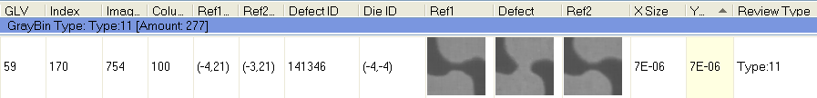
ADC – Request
Default category header for e-manager
Recommend following items put on the header as default setting.
Defect index -- Index, Defect ID, Die ID, OPFlag, Image ID, Column ID, IX, IY
Defect image -- Ref1, Defect, Ref2
Defect location -- Defect positionX for die, Defect positionY for die
Signal -- Threshold, GLV, DGLV, RGLV
Sizing – Defect sizeX, Defect sizeY, Defect Area
Grouping – Review type, ADC type,

Slide 13
Feature Test

Slide 14
ADC – Feature list
Feature list comes from SW team

Slide 15
ADC – Feature list
Tested and found successful case
Feature1&2 are good to separate BVC\DVC and wrong reference
Tested but didn’t find successful case
Feature50, 51 and 53 are good to separate different sizing defects
Feature9 is good to separate wrong reference
Feature10 is good to separate misalignment false
Feature56, 57 and 53 are good to separate metal bridge
Feature11 is good to for the misalign btw Ref1 and Ref2
Feature12 is good to separate glitching false and bridge defects

Slide 16
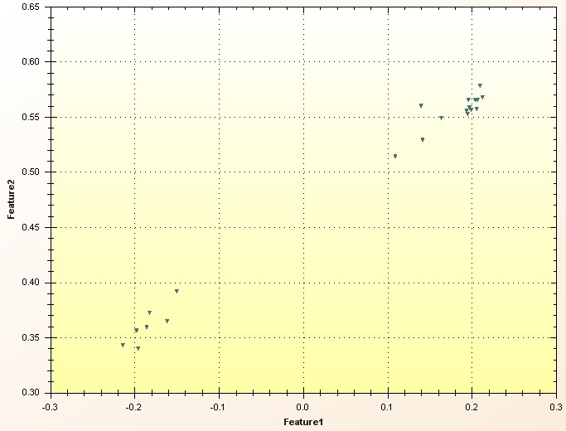
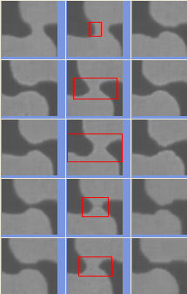
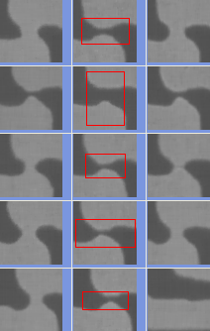
ADC – Feature test – BVC \ DVC
Testing feature:
Defect Magnitude (1) and Intensity (2)
Summary:
Easy to separate DOI and Wrong Reference

Slide 17
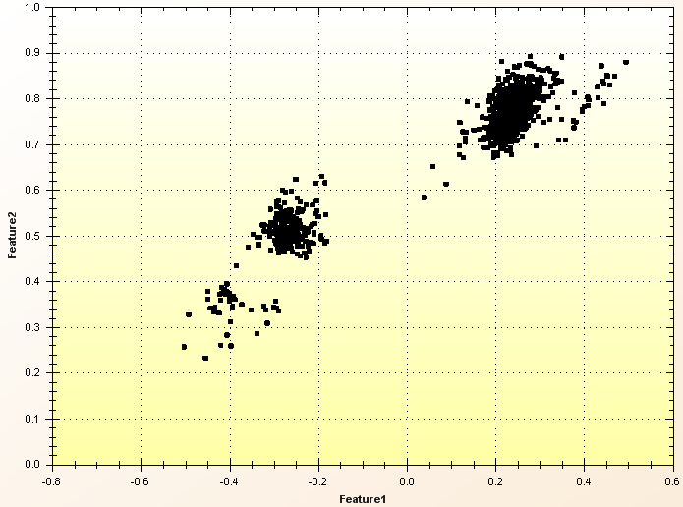
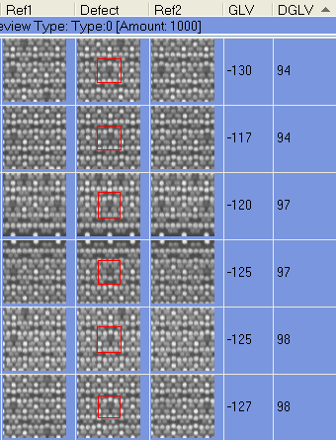
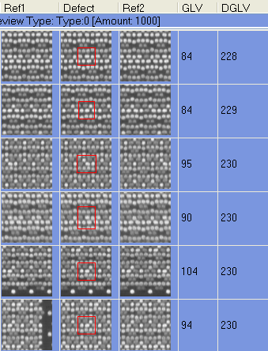
ADC – Feature test – BVC \ DVC
Testing feature:
Defect Magnitude (1) and Intensity (2)
Summary:
These two functions are very close to the GLV or DGLV
Feature name is proper?

Slide 18
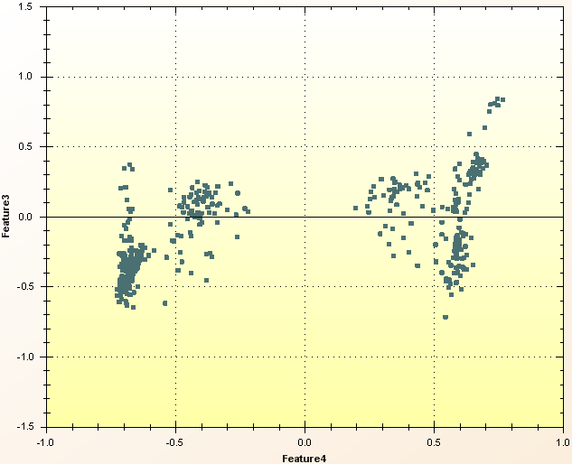
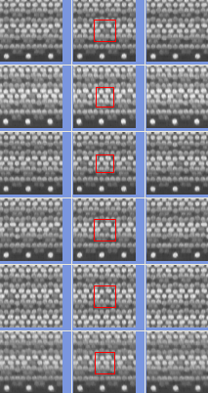
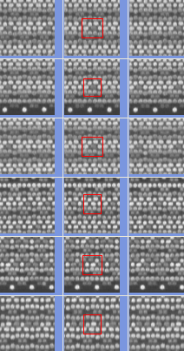
ADC – Feature test – BVC \ DVC
Testing feature:
Defect GLV Ratio (3) and Defect GLV Area (4)
Summary:
These two features are “NOT” able to separate BVC/DVC and the size of defects.
DVC
DVC
BVC
BVC

Slide 19
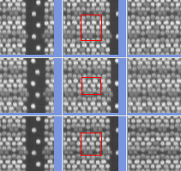
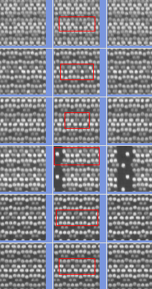
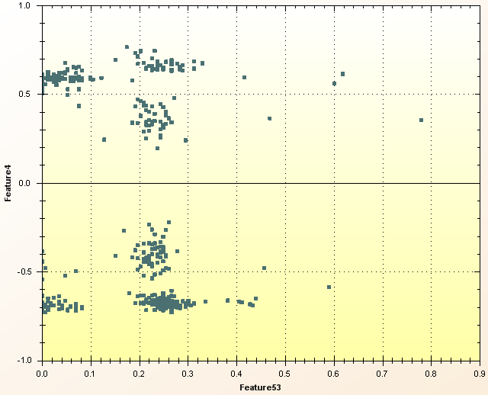
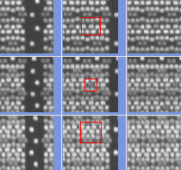
ADC – Feature test – BVC \ DVC
Testing feature:
Defect GLV Area (4) and Defect Area (53)
Summary:
What is the real function for Defect GLV Area?
All of them are single VC and located near the page break.
Most of them are multiple VC. Defect area should be right. But Defect GLV Area is not correct.

Slide 20
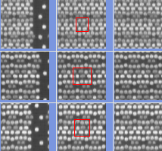
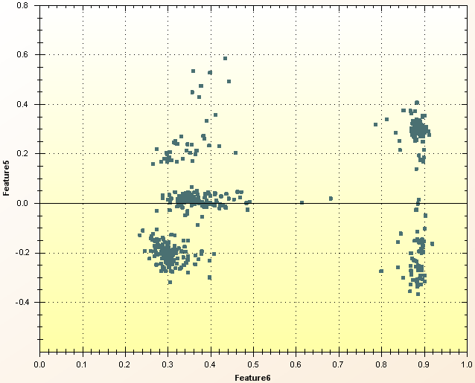
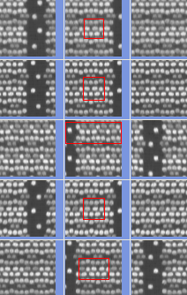
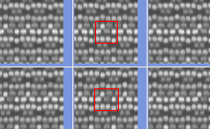
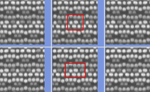
ADC – Feature test – BVC \ DVC
Testing feature:
Defect GLV Ratio Area (5) and Difference GLV Dev (6)
Summary:
What is the real function for Defect GLV Ratio Area (5) and Difference GLV Dev (6)?
All of them are single BVC or DVC. No relationship of Area.
Most of them are single VC. No idea what the function of Difference GLV Dev.

Slide 21
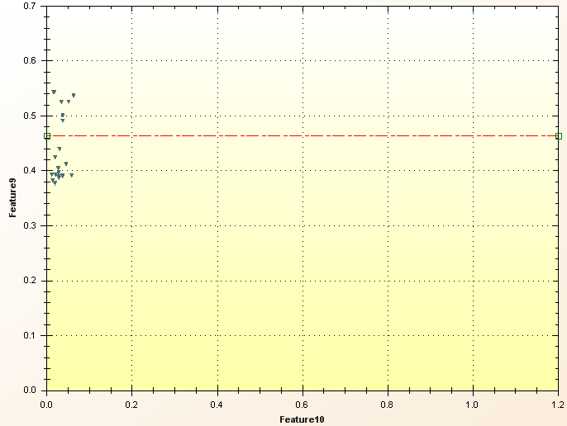
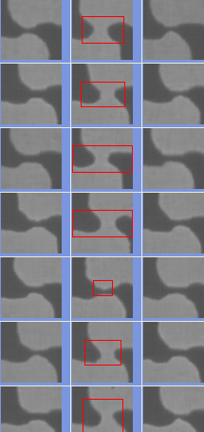
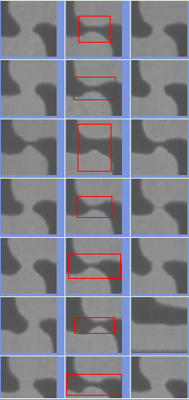
ADC – Feature test – Misalignment
Testing feature:
Reference GLV (9)
Summary:
This feature is easy to separate DOI and Wrong Reference
Normal DOI
Wrong reference

Slide 22
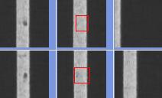
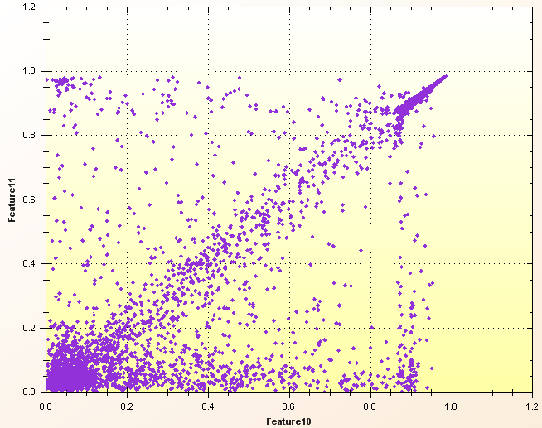
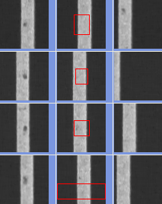
ADC – Feature test – Misalignment
Testing feature:
Defect Ref1 Misalignment (10) ; Reference Misalignment (11)
Summary:
Defect Ref1 Misalignment (10) is good to separate misaligned false but hard to separate glitch false.
Reference Misalignment (11) is only judging the reality of the defect. It is for the comparison btw Ref1 and Ref2. Smaller no. of this, higher chance to get real DOI.
Feature 11 = Reference Misalignment
No misaligned false but some glitch false
Feature 10 = Defect Ref1 Misalignment

Slide 23
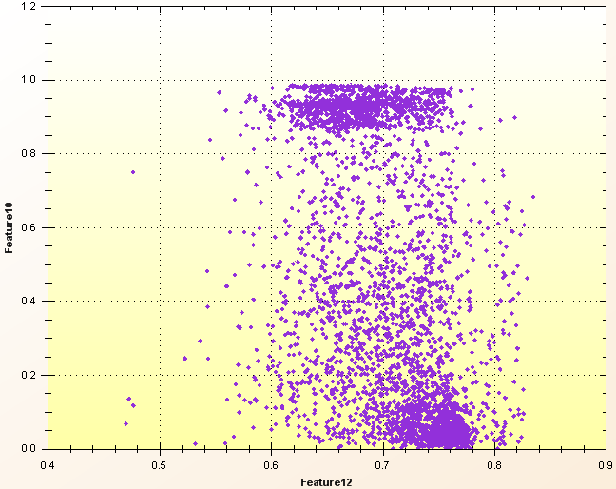
ADC – Feature test – Misalignment
Testing feature:
Defect Ref1 Misalignment (10) ; False defect (12)
Summary:
Defect Ref1 Misalignment (10) is good to separate misaligned false but hard to separate glitch false.
False defect (12) is good to separate normal defect and glitch false
Feature 10 = Defect Ref1 Misalignment

Slide 24
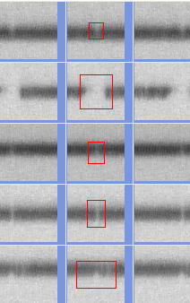
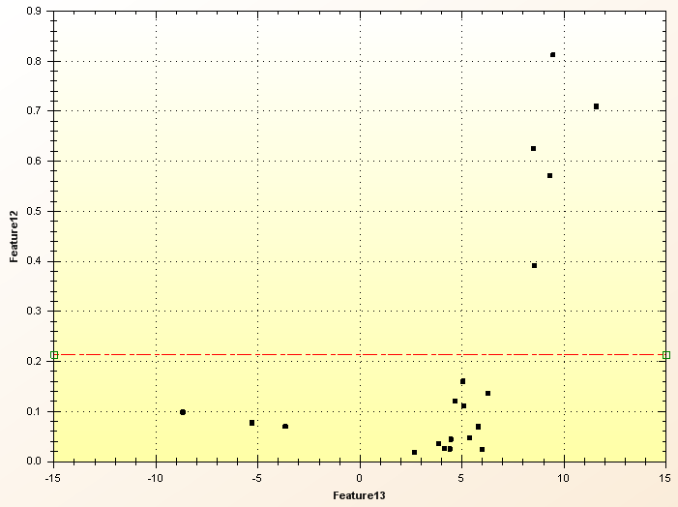
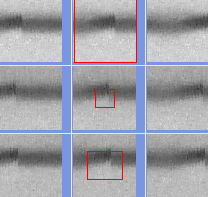
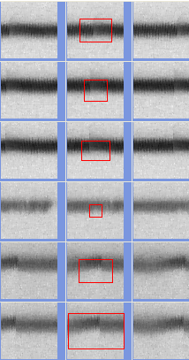
ADC – Feature test – Misalignment
Testing feature:
False defect (12)
Summary:
This feature is easy to separate DOI open and glitch false
Feature 12 = Mis-False defect

Slide 25
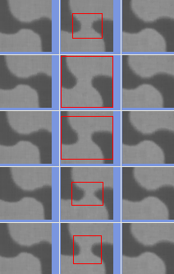
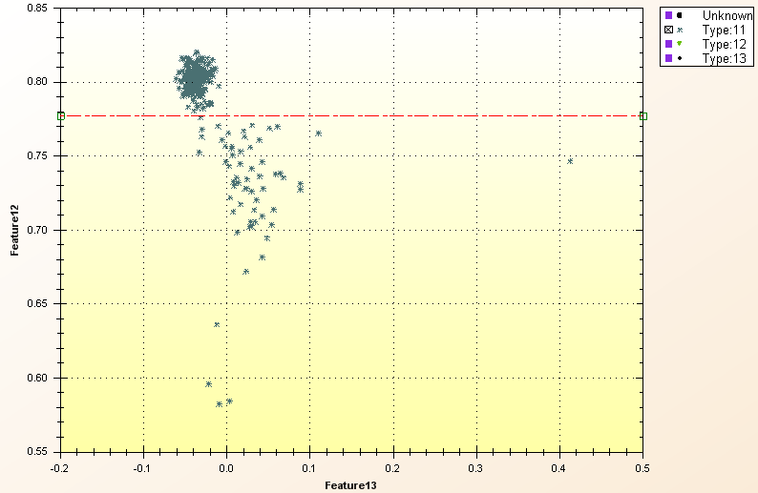
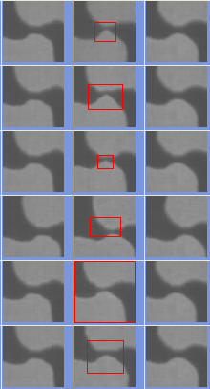
ADC – Feature test – Misalignment
Testing feature:
False defect (12)
Summary:
This feature is easy to separate bridge and non-bridge
Feature 12 = Mis-False defect

Slide 26
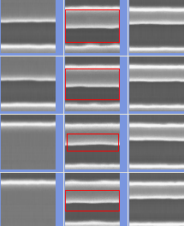
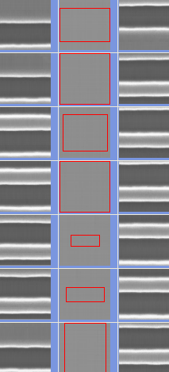
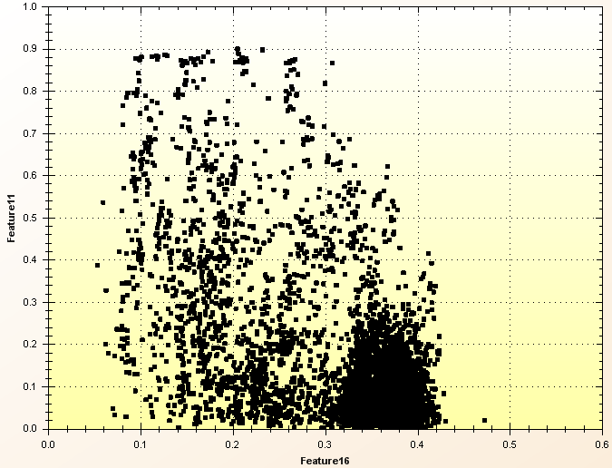
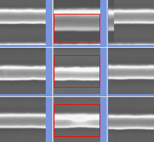
ADC – Feature test – Pattern
Testing feature:
Reference GL Dev (16) ; Reference Misalignment (11)
Summary:
Reference GL Dev(16) is OK to separate “No pattern” defects and Reference Misalignment(11) is OK to separate difference btw Ref1 and Ref2
Different Ref.
No pattern
Real DOI

Slide 27




















ADC – Feature test – Sizing (Original code)
Testing feature:
Defect Width (50)
Defect Height (51)
Defect Area (53)
Summary:
It’s “NOT” working on old code.
Defect ID: 126070 → Width 0.43 \ Height 0.1 \ Area 0.6
Defect ID: 14360 → Width 0.45 \ Height 0.15 \ Area 0
Defect ID: 10174 → Width 0.48 \ Height 0.21 \ Area 0.88
Defect ID: 4328 → Width 0.21 \ Height 0.24 \ Area 0.24
Defect ID: 109810 → Width 0.18 \ Height 0.75 \ Area 0.95

Slide 28
ADC – Feature test – Sizing (New modified)
Testing feature:
Defect Width (50)
Defect Height (51)
Defect Area (53)
Summary:
It’s more reasonable for new code. But needs to test more results to confirm.
Defect ID: 126070 → Width 0.38 \ Height 0.16 \ Area 0.07
Defect ID: 14360 → Width 0.24 \ Height 0.11 \ Area 0.09
Defect ID: 10174 → Width 0.67 \ Height 0.45 \ Area 0.32
Defect ID: 4328 → Width 0.08 \ Height 0.09 \ Area 0.024
Defect ID: 109810 → Width 0.19 \ Height 0.83 \ Area 0.42

Slide 29
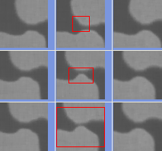
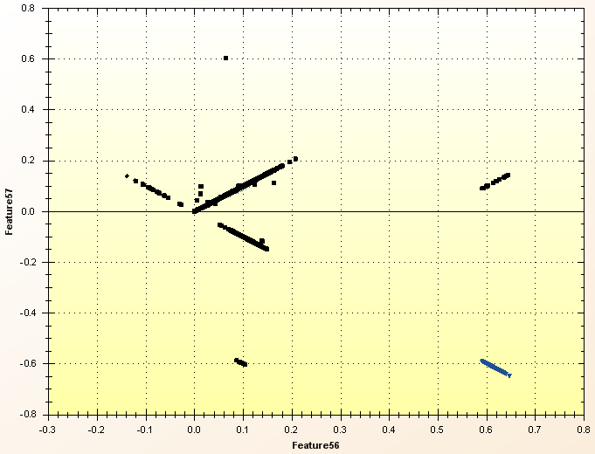
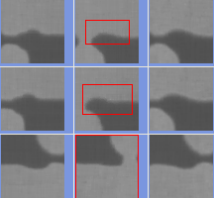
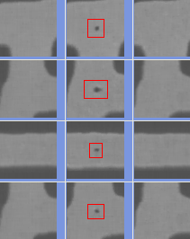
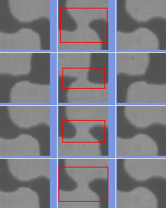
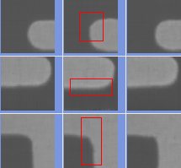
ADC – Feature test – Metal Bridge
Testing feature: These two features were released at SW1.0.2
Metal Bridge Bright (56): Higher “Metal Bridge Bright”, larger bright area is.
Metal Bridge Dark (57): Higher “Metal Bridge Dark”, larger dark area is.
Summary:
Very good tool to separate metal bridge and metal non-bridge

Slide 30
New Classification Type Test
Pattern Group

Slide 31
ADC – New classification --Pattern group
Summary
Pattern group has two options. One is manual grouping and another one is auto grouping.
It is grouping by using whole patch image matching on “Reference patch” or “Defect patch”. Typically, reference patch is better to try first.
After testing, it is very powerful on periphery results since it has a lot different types of DOI.
This function has been released and could apply it on classification tree.
User could use Ref1

Slide 32
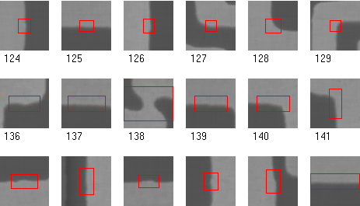
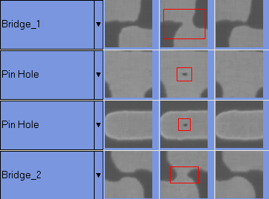
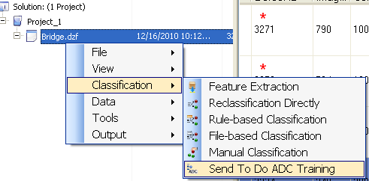
ADC – New classification --Pattern group
Step 1
How to use the function of “Pattern Group”.
A. Manual setting:
Recognize the DOI.
Apply a Review Type name you want.
Send to ADC training
Step 2
Step 3

Slide 33
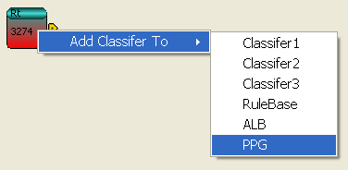
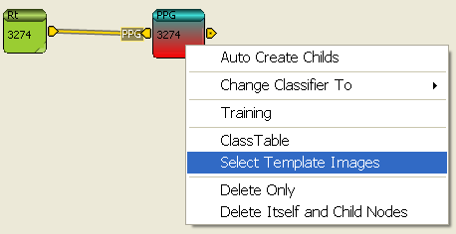
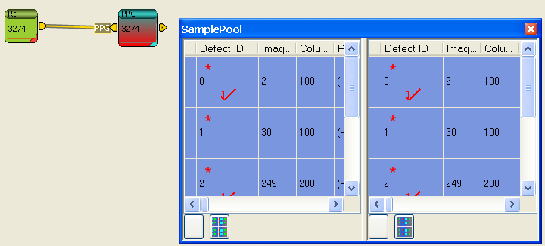
ADC – New classification --Pattern group
Step 4
How to use the function of “Pattern Group”.
A. Manual setting:
4. High light PPG grouping and drag sampling defects on both box of “SamplePool”.
5. Apply a Review Type name you want.
6. Right click on PPG grouping and click ”Sent Template Images”.
Step 6
Step 5

Slide 34






ADC – New classification --Pattern group
Step 7
How to use the function of “Pattern Group”.
A. Manual setting:
7. Apply setting on template including”
Zooming size.
Sampling defects choosing.
Review type.
Grouping image based.
Threshold setting
8. Click
9. Right click of PPG grouping and click “Auto Create Childs”
Step 8
Step 9

Slide 35


ADC – New classification --Pattern group
Step 10
How to use the function of “Pattern Group”.
A. Manual setting:
10. Click “Training” bottom.
11. Click OK bottom after training complete.
12. Check all classified defects. If the accuracy is not good enough, go back step 7 to adjust the threshold or grouping image based again.
Step 11

Slide 36



ADC – New classification --Pattern group
Step 1
How to use the function of “Pattern Group”.
B. Auto setting:
1. PatchImageGrouping
2. Apply threshold on Patch Image Grouping box.
3. After “Run”, check the “GrayBin” to see the results.
Step 12

Slide 37
New Classification Type Test
ALB (Automatic Location Binning)

Slide 38
ADC – New classification --ALB
Summary
It is grouping by image pattern matching on “Reference patch” and “Defect patch”. Choosing searching range on reference patch and location range on defect patch.
After testing, it is very powerful on repeatable image pattern (Like WCMP on cell).
Three main parameters to make a good classifier including “Threshold”, “Priority” and “Area marking”. No index to judge how to improve these three index. SW team is working on creating an off-line template to report all matching results on each DOI type. Here is the example.
Index DOI1 DOI2 DOI3 DOI4
ID1 60% 85% 45% 36%
ID2 65% 45% 90% 56%

Slide 39


ADC – New classification --ALB
How to use the function of “ALB”.
1. In the ADC Training Design GUI, open and connect “ALB”
2. Click ALB and drag the desired defect to sampling pool.
Step 1
Step 2

Slide 40



ADC – New classification --ALB
Step 3
How to use the function of “ALB”.
3. Right click ALB and choose “Select Template Images”
4. Enlarge the sampling image (like 800%).
Step 4

Slide 41

ADC – New classification --ALB
How to use the function of “ALB”.
5. Confirm the DOI types which want to be classified (For exampled as shown below)
Step 5
CA1
CA2
CA3
CA4
CB1
CB2
CB3

Slide 42

ADC – New classification --ALB
How to use the function of “ALB”.
6. Use “Cut Image” bottom to cut a repeatable image. This is very important to include all repeatable pattern.
Step 6

Slide 43


ADC – New classification --ALB
How to use the function of “ALB”.
7. Define DOI type and mark them on template.
8. Apply a threshold for this group.
9. Click X
Step 9
Step 7
Step 8

Slide 44


ADC – New classification --ALB
Step 11
How to use the function of “ALB”.
10. Right click of the ALB again and click “ Auto Create Childs”
11. Click “Training” bottom.
12. Check the results on ADC. Fine tune TH if necessary.
Step 10
Step 12

Slide 45
New Classification Type Test
Classifier4 (C4)

Slide 46
User Manual for Classifier4 (C4)
2016 Nov (V2)

Slide 47
Concept of Classifier4 (C4)
Classifier4 (C4) is a classifier consists of a set of decision trees, constructed by selecting a subset of features randomly; classification is done by majority voting of the decision trees.
Available in eManager from version 3.2.0.0 onwards.

Slide 48

Classifier4 Node
Select “Classifier4” (“C4”) node :

Slide 49


Classifier4 Settings
It has two parameter settings:
Forest number: Number of trees in the Forest & Default=100, range=100 to 500.
Forest variable: The number of variable (features) randomly selected during tree construction & Default=16, range= 16 to 24.
Has good performance when parameters set as:
Forest number=400, Forest variable = 24
In general, larger values give better performance (but decrease throughput).
Rest of design procedure is similar to Classifier 1, 2, and 3.

Slide 50
Different Classifiers in eManager
Classifier | Descriptions | Feature Selection | Training Time | Classification Time
Classifier 1 | Neural Network Classifier Better for multiple defect types | Necessary for better ADC performance | Fast | Fast
Classifier 2 | Usually give good classification purity Need user to set a purity rate | Necessary for better ADC performance | Fast | Slow (Depend On Sample Count)
Classifier 3 | Adaboosting Classifier Better for few ( 2, 3, 4 etc.) defect types. | Unnecessary | Slow | Fast
Classifier 4 | Under testing | Unnecessary, it has it’s own internal selection during training | Fast | Fast
Rule-Based Classifier | If some rules can classify different types | Unnecessary | Very fast | Very Fast

Slide 51
Real Case Illustration
Case1

Slide 52
ADC – Real case illustration – Case1
DOI
BVC
DVC
Nuisance

Slide 53



ADC – Real case illustration – Case1
Feature 53 (Area)
Feature 1 (Magnitude)
Pattern Group
DVC
Nuisance

Slide 54


ADC – Real case illustration – Case1
Used traditional classifier, the accuracy is 82.96%
Used feature tree (With pattern group), the accuracy is 97%

Slide 55
Real Case Illustration
Case2

Slide 56



ADC – Real case illustration – Case2
Used Classifier scheme (By very professional expert)
Spend time：50 min.
Glitch
Normal
MA

Slide 57


ADC – Real case illustration – Case2 Random selected defects: 100ea

Slide 58



ADC – Real case illustration – Case2 Used Feature Tree
Spend time：<10 min.
Glitch
Normal
MA

Slide 59


ADC – Real case illustration – Case2 Random selected defects: 100ea

Slide 60
ADC – Real case illustration – Case2 Final comparison btw classifier and feature
Spend time：50 min.
Classifier scheme
Used traditional classifier, the accuracy is 81%
Spend time：<10 min.
Feature scheme
Used feature tree (No pattern group), the accuracy is 83%

Slide 61
Real Case Illustration
Case3

Slide 62
ADC – Real case illustration – Case3
DOI and Nuisance
DVC
BVC
Nuisance

Slide 63

ADC – Real case illustration – Case3 ADC Accuracy & Purity
Spend time：<20 min.
Feature scheme
Used pattern group, the accuracy is 97.24%

Slide 64
Thank You !!

